Slide 1
WEB DESIGN PROJECT
PRESENTATION
CONTRIBUTORS
SHIVA TEJA DASI
CHALAPATI RAO KONUJULA
SAI NIKHIL REDDY CHALLA
ANTHONY KODIREKKA

Slide 2
PanoramaEd
PanoramaEd is a revolutionary web app designed to empower students in their pursuit of the perfect international college experience. Our platform offers a comprehensive suite of features tailored to guide and support students through every step of their journey toward higher education abroad.

Slide 3
KEY FEATURES
01
04
Explore colleges worldwide
Dynamic college comparison
02
05
Personalized consultants
Student driven insights
03
06
College predictor
Multilingual support
Navigate through an extensive database of colleges around the globe.
Make confident decisions with our intuitive comparison tools.
Connect with experienced consultants to receive personalized guidance and advice.
Hear from your peers! PanoramaEd provides a platform for students to share their admission journeys.
Fill your details and get a list of suggested colleges you can get into
PanoramaEd transcends language barriers, offering support in multiple languages.

Slide 4










TECH STACK USED

Slide 5
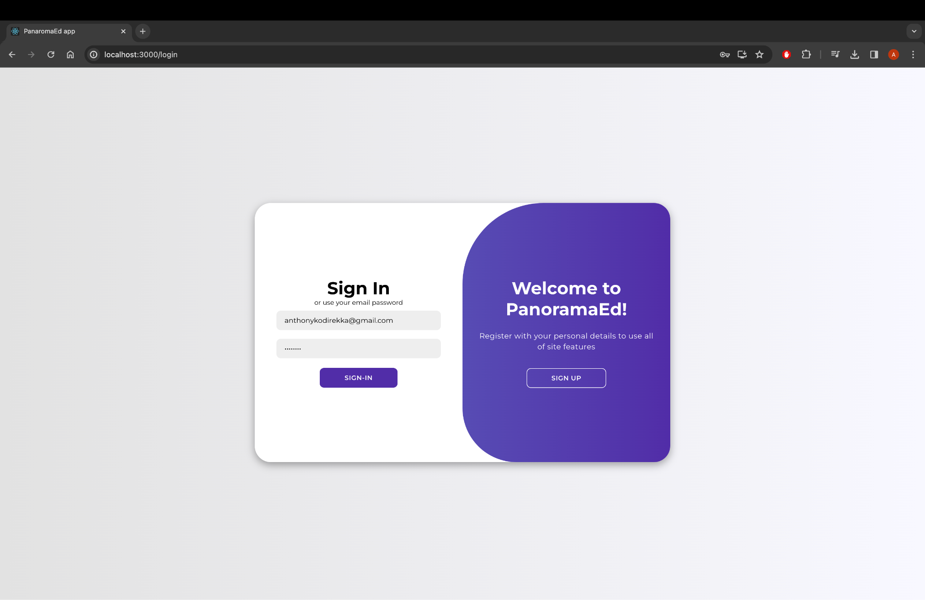
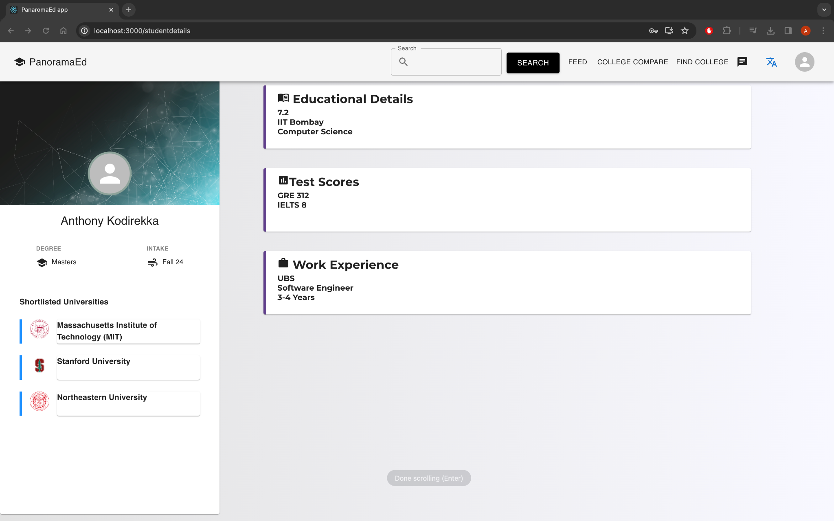
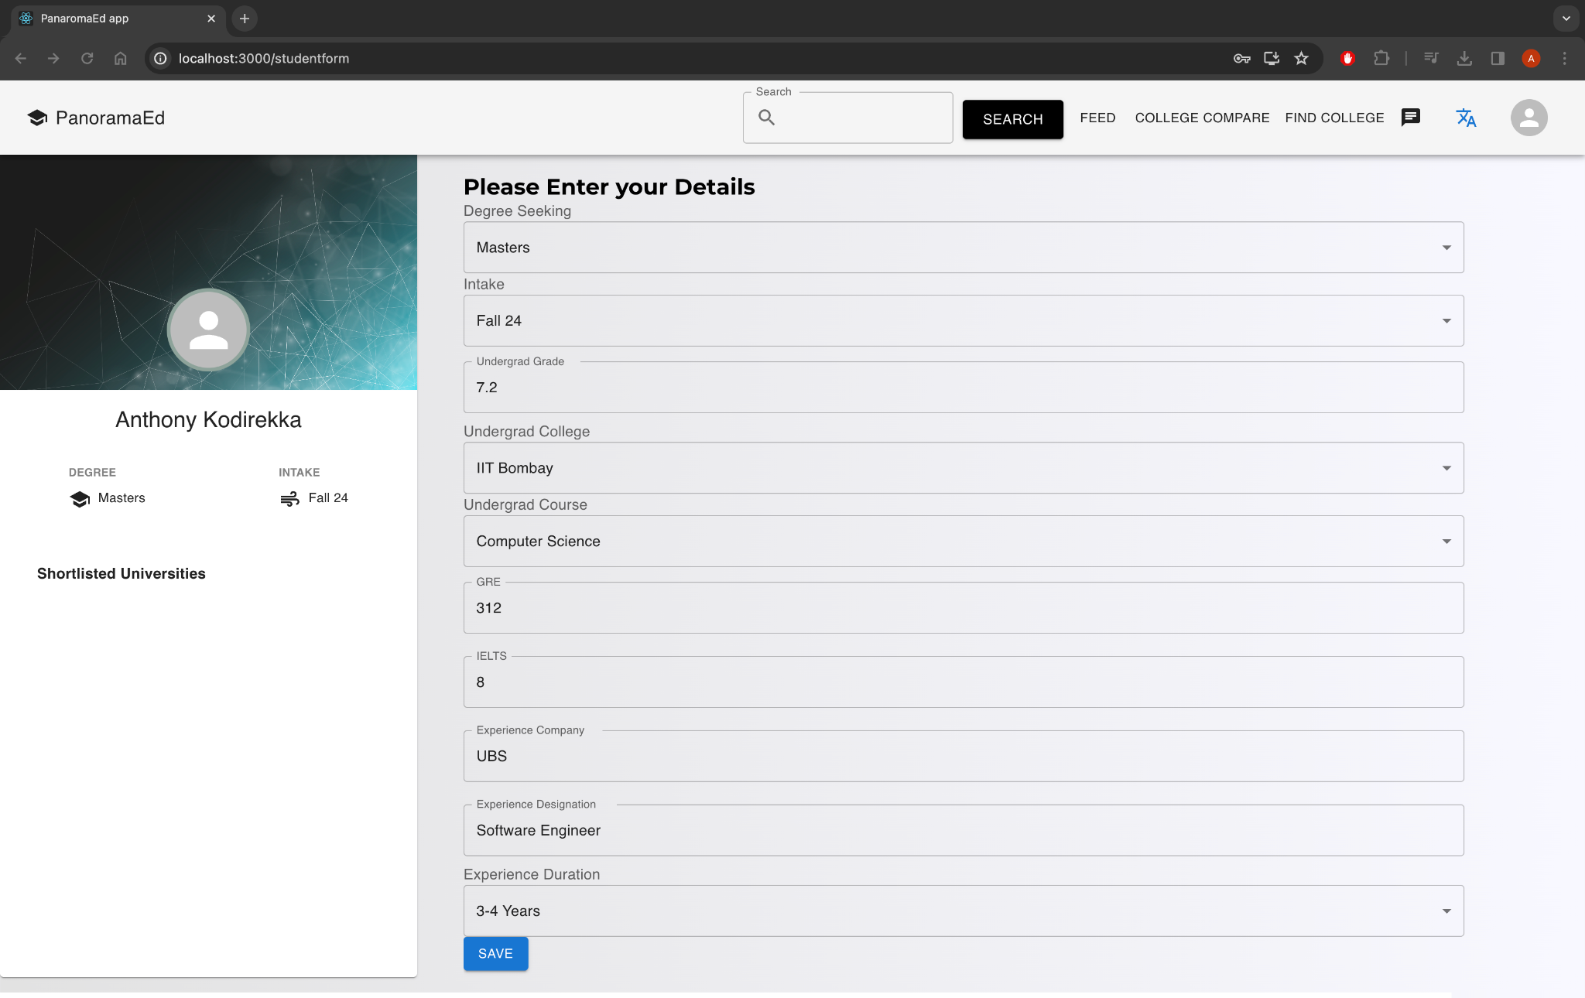
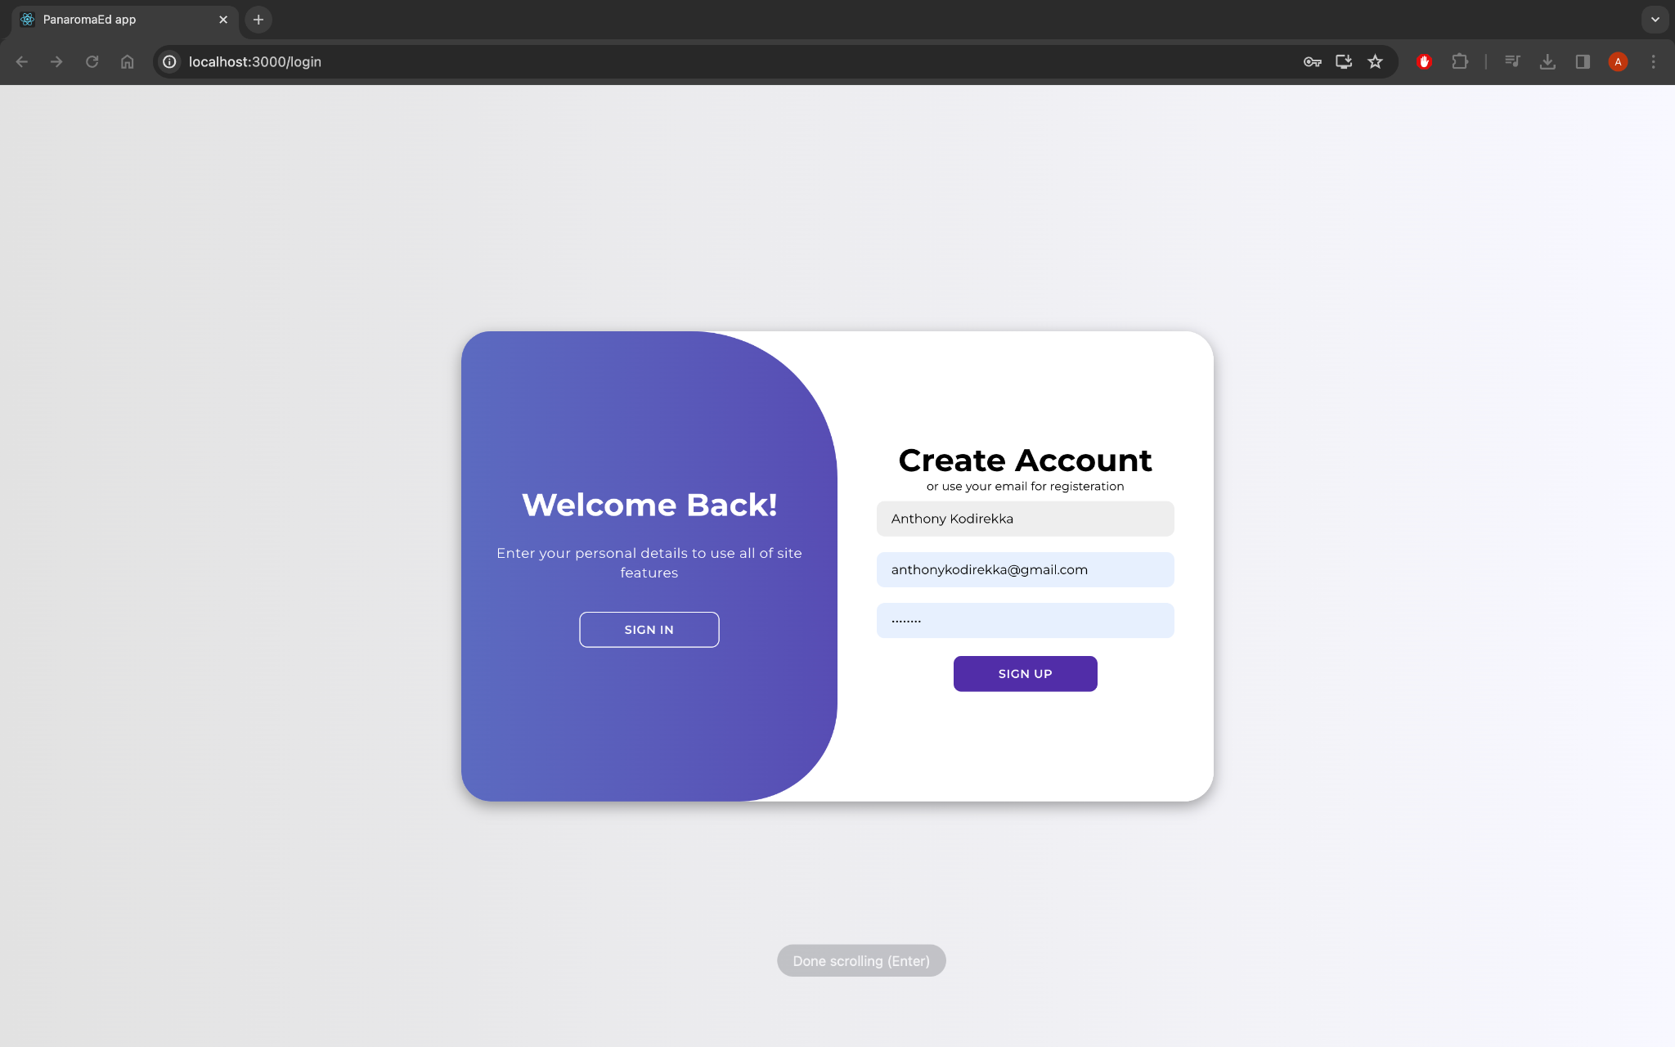
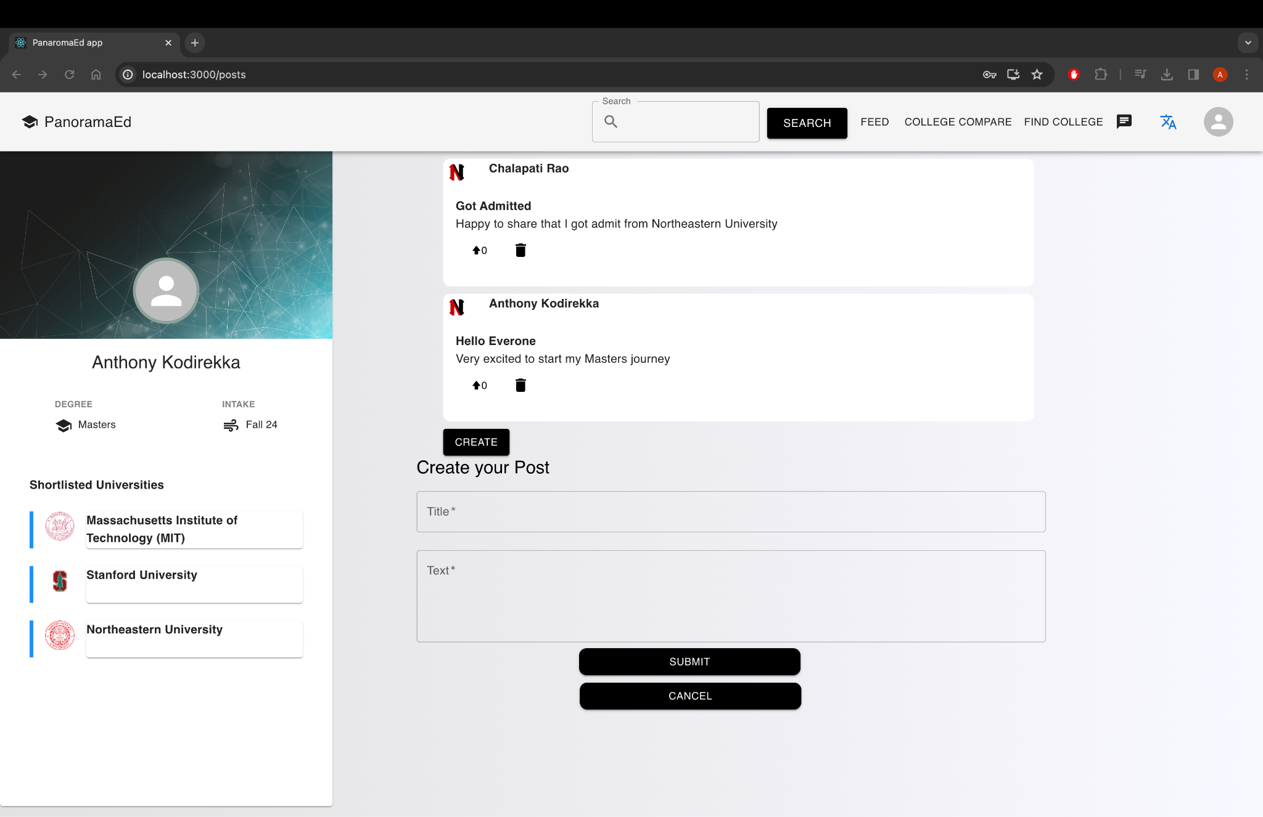
Snapshots

Slide 6
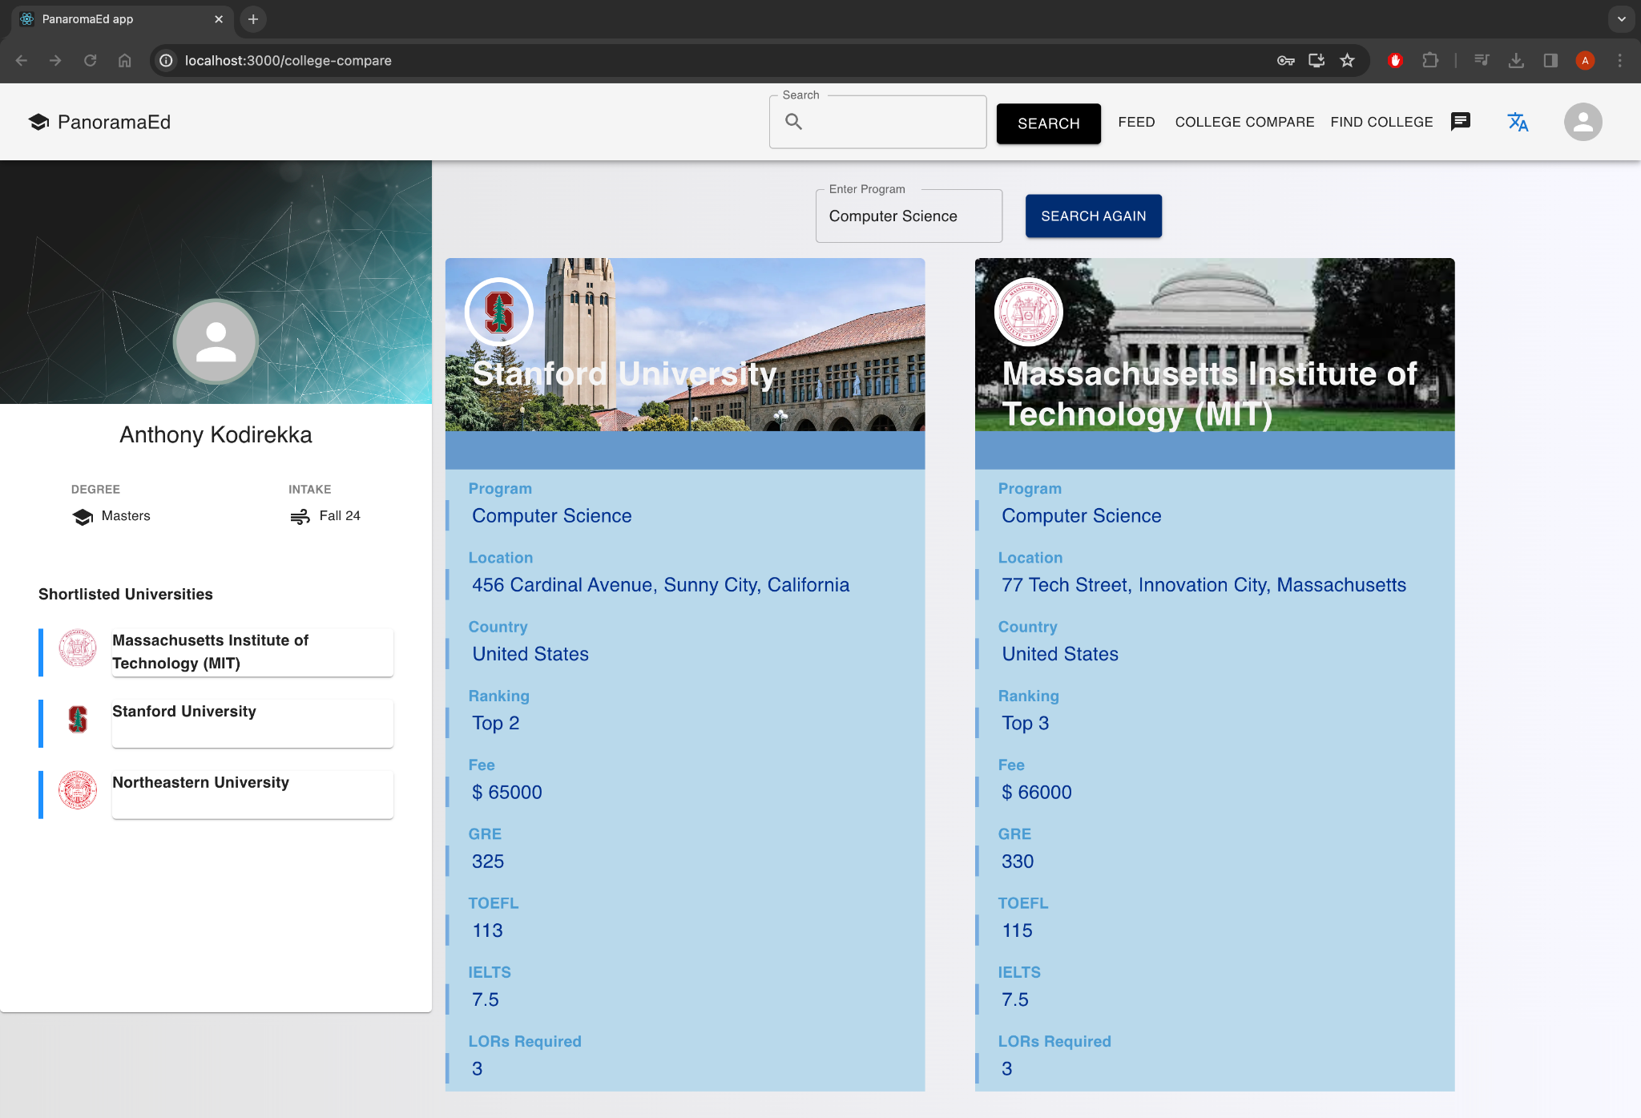
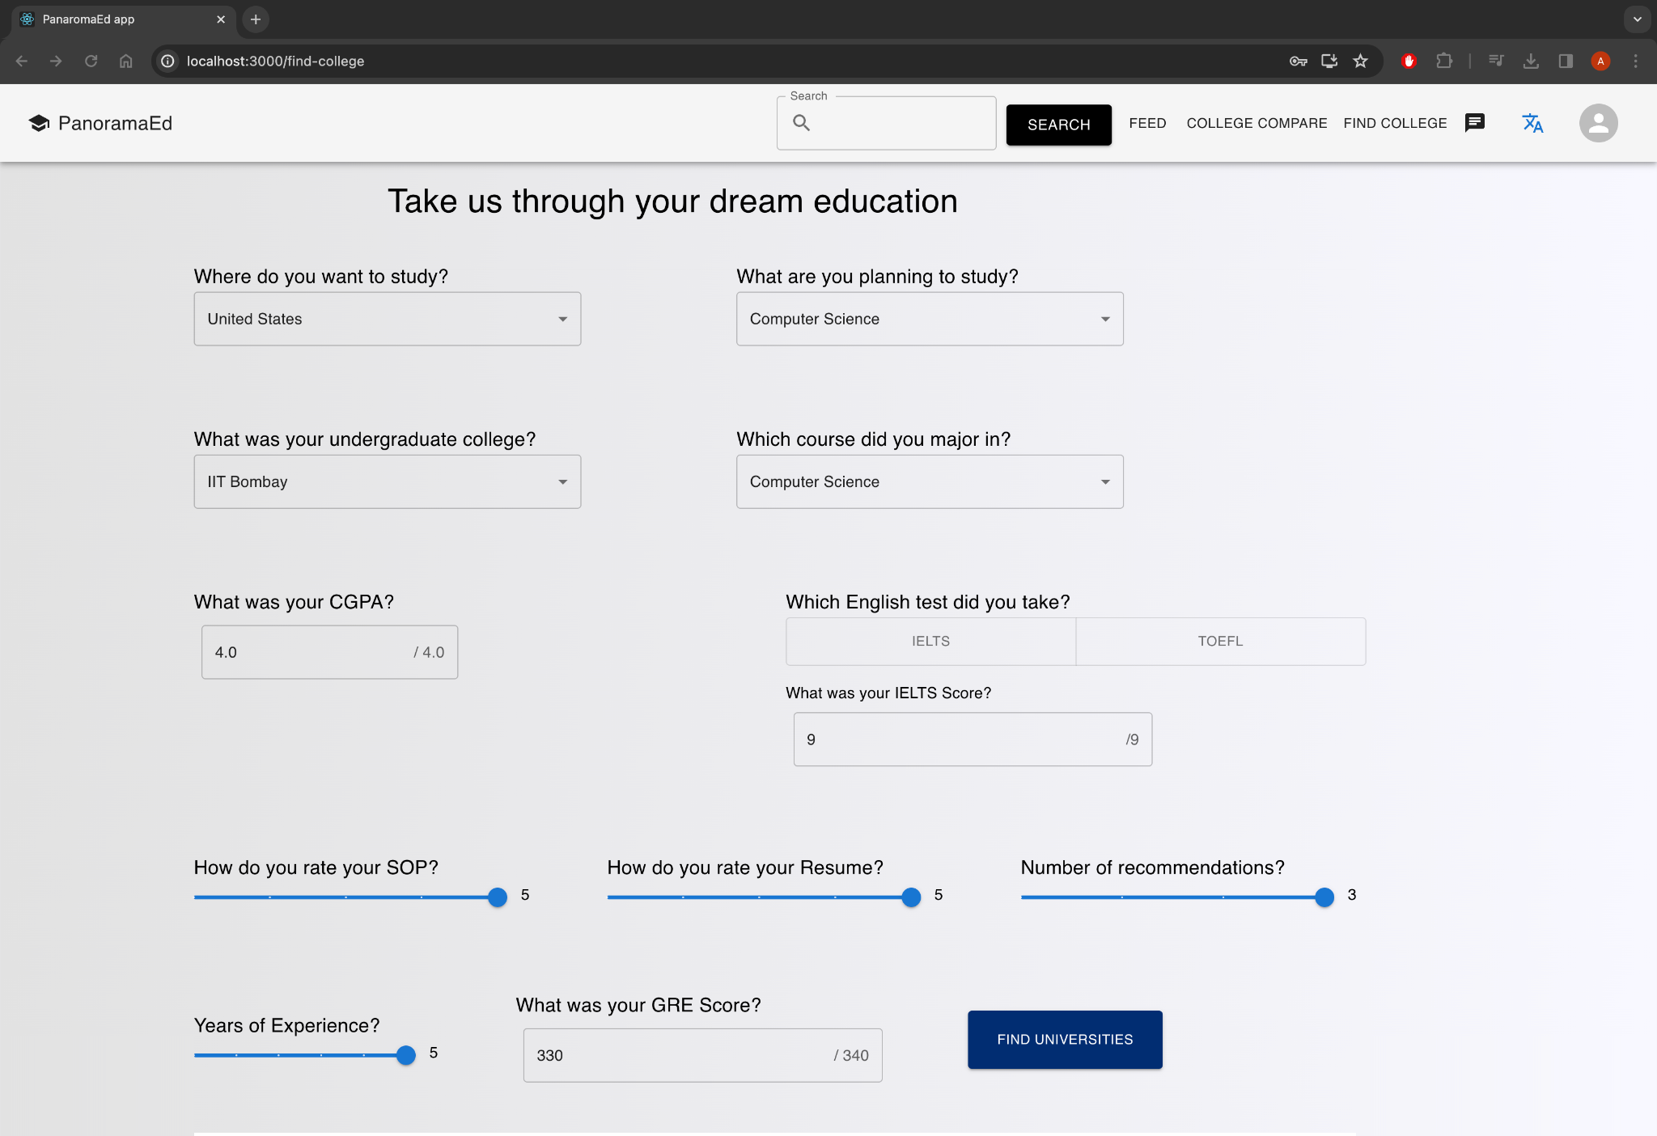
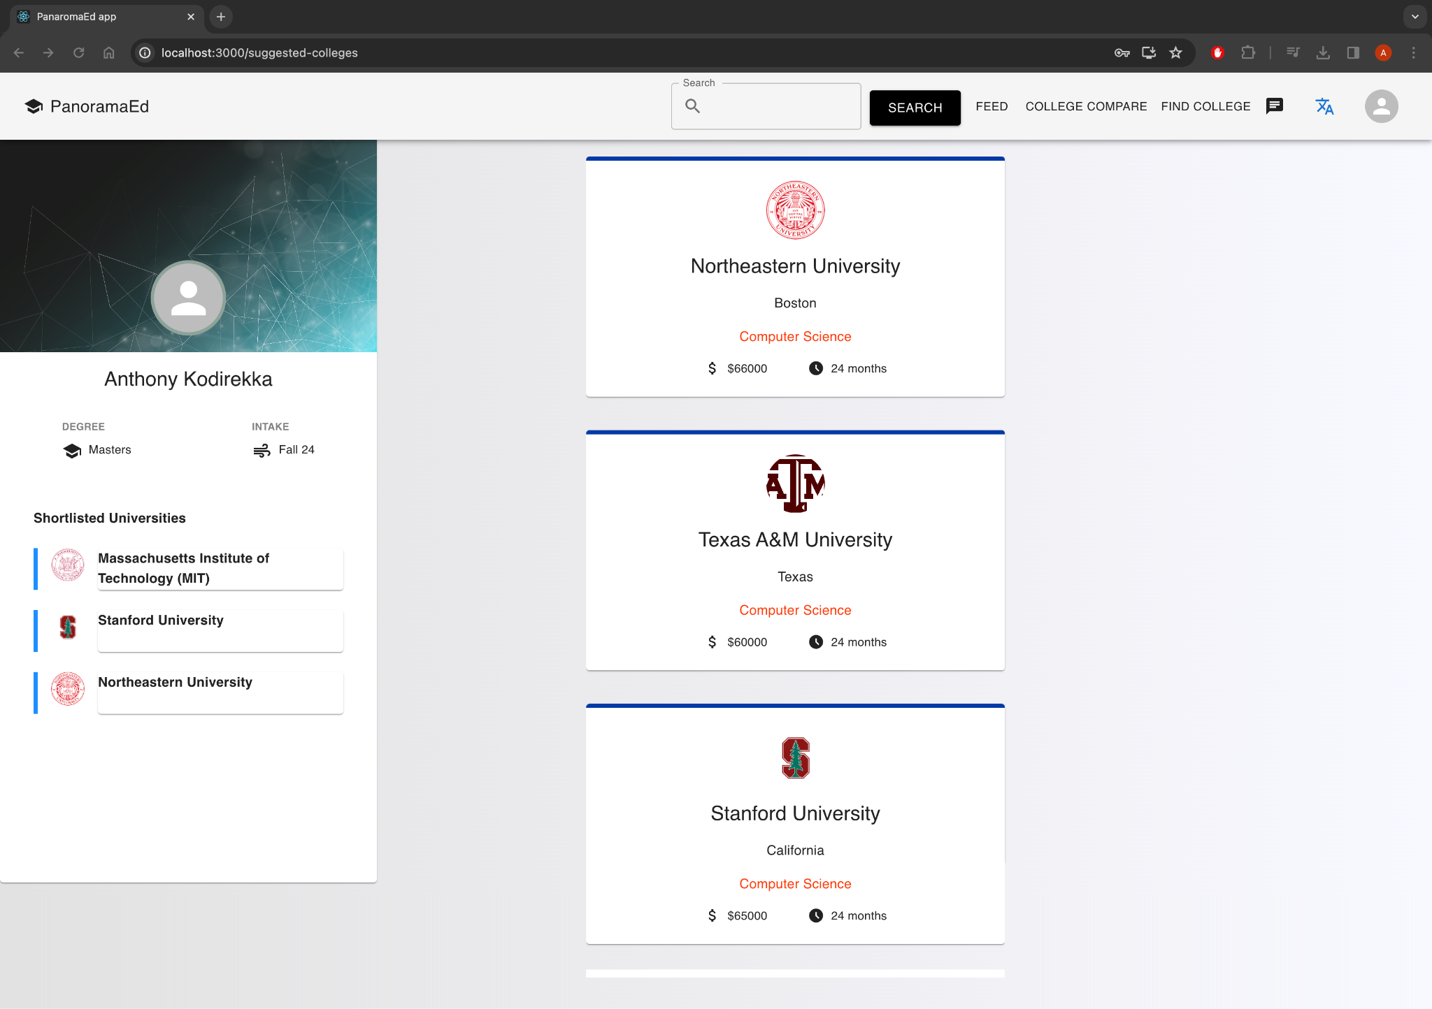

Slide 7
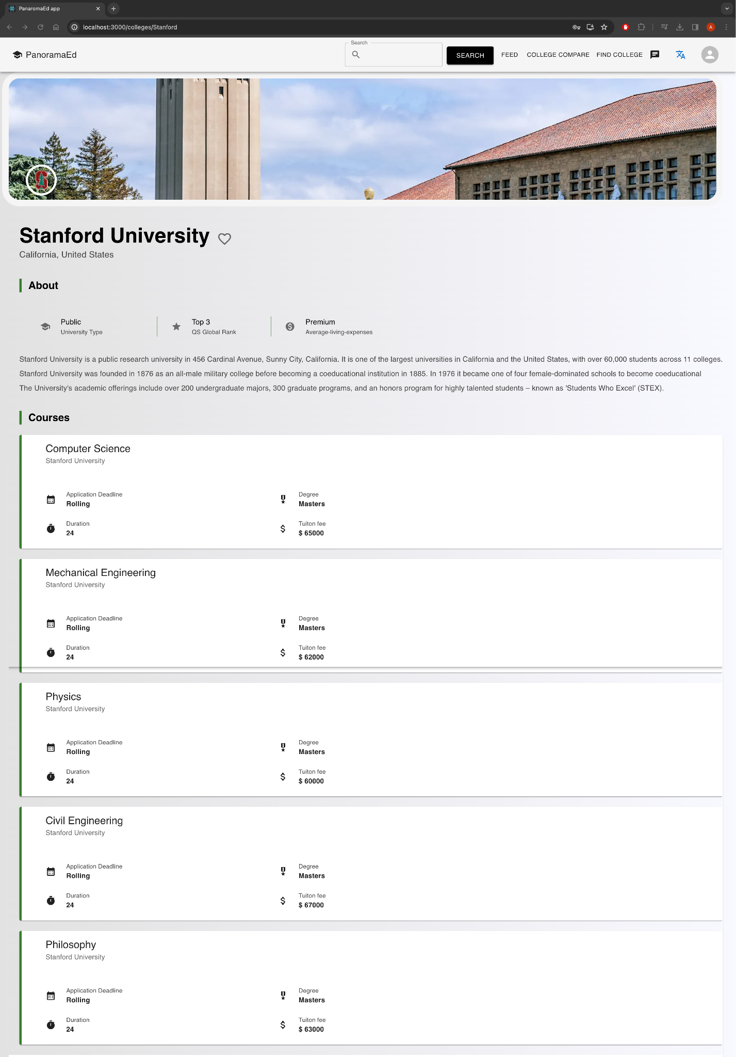
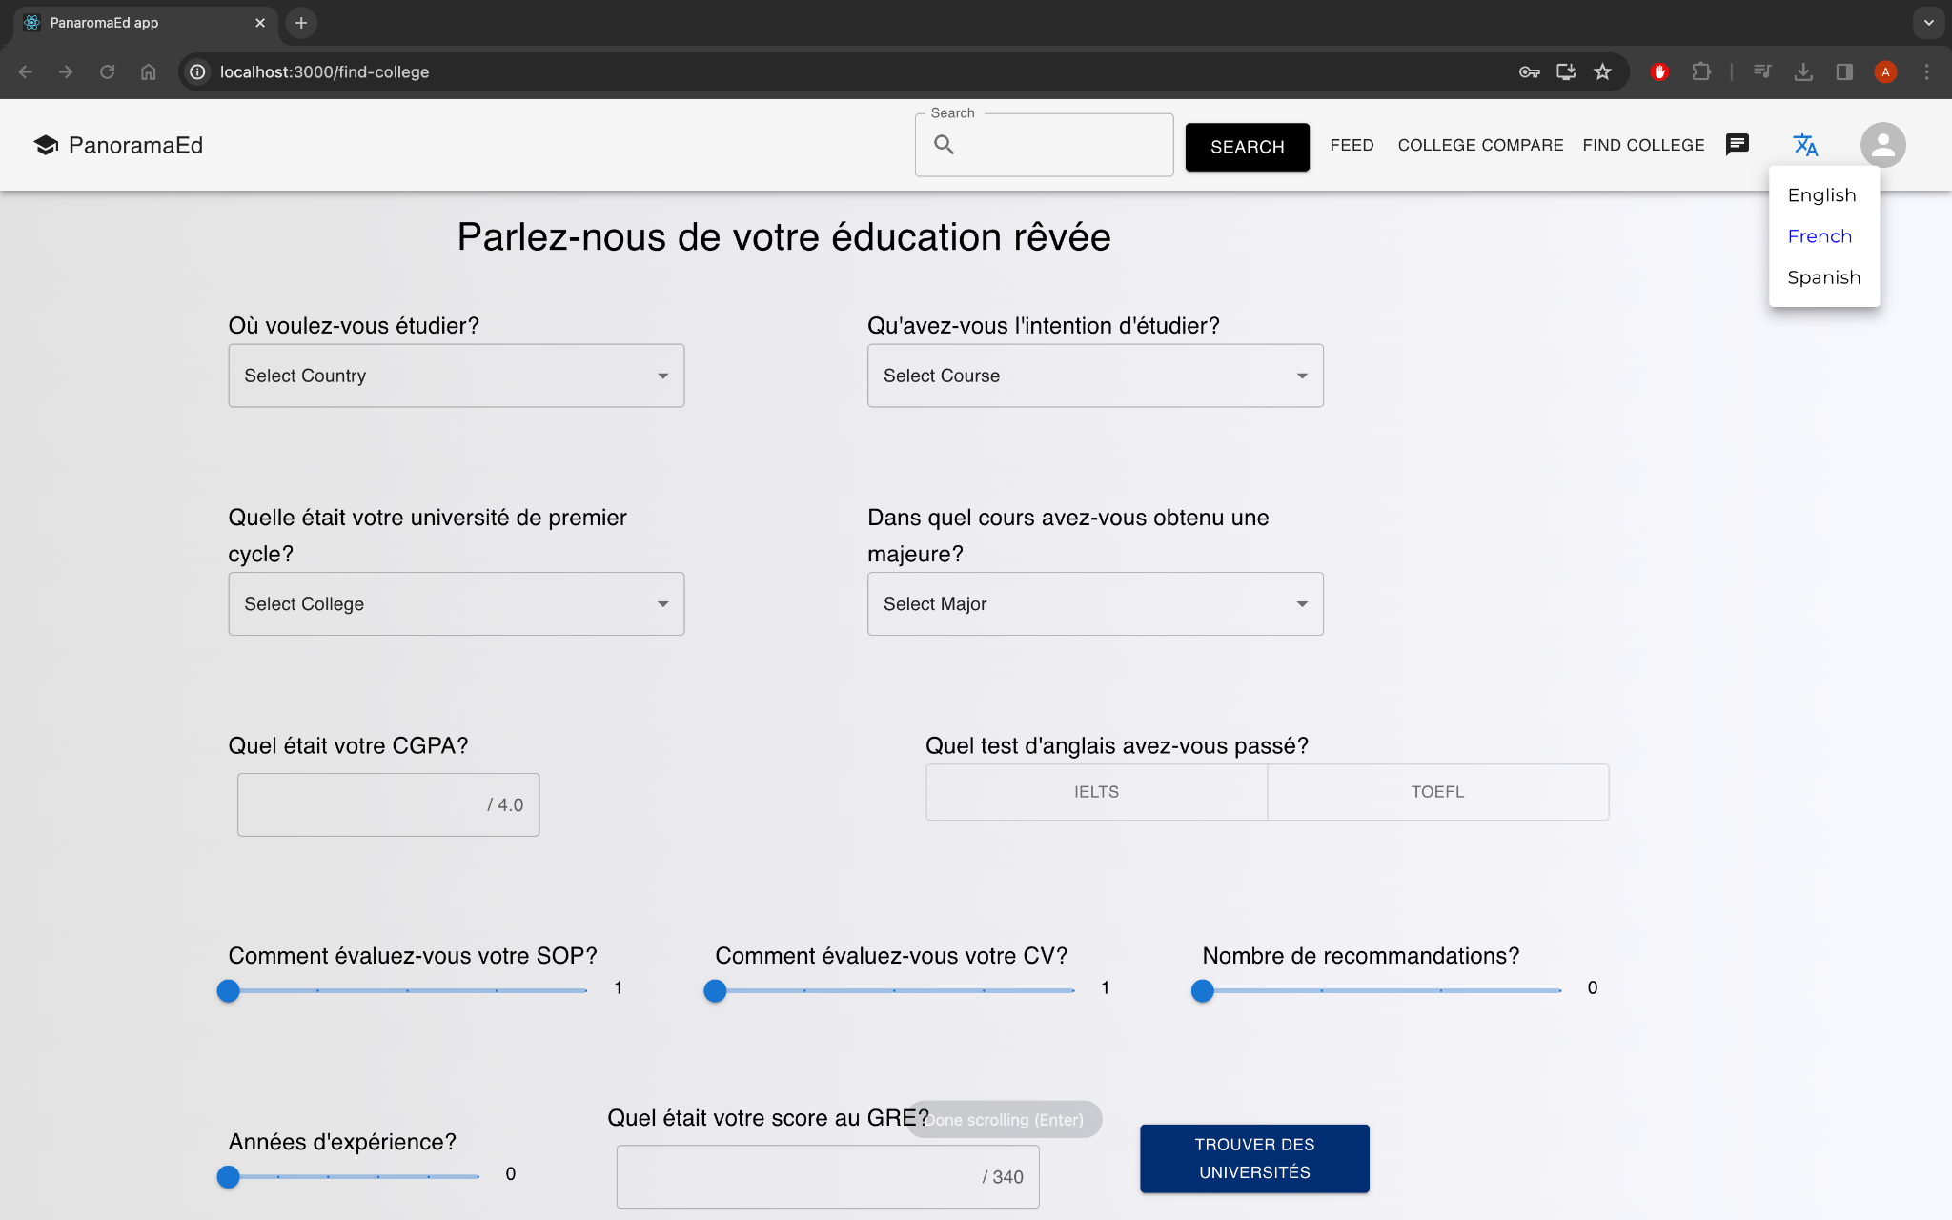
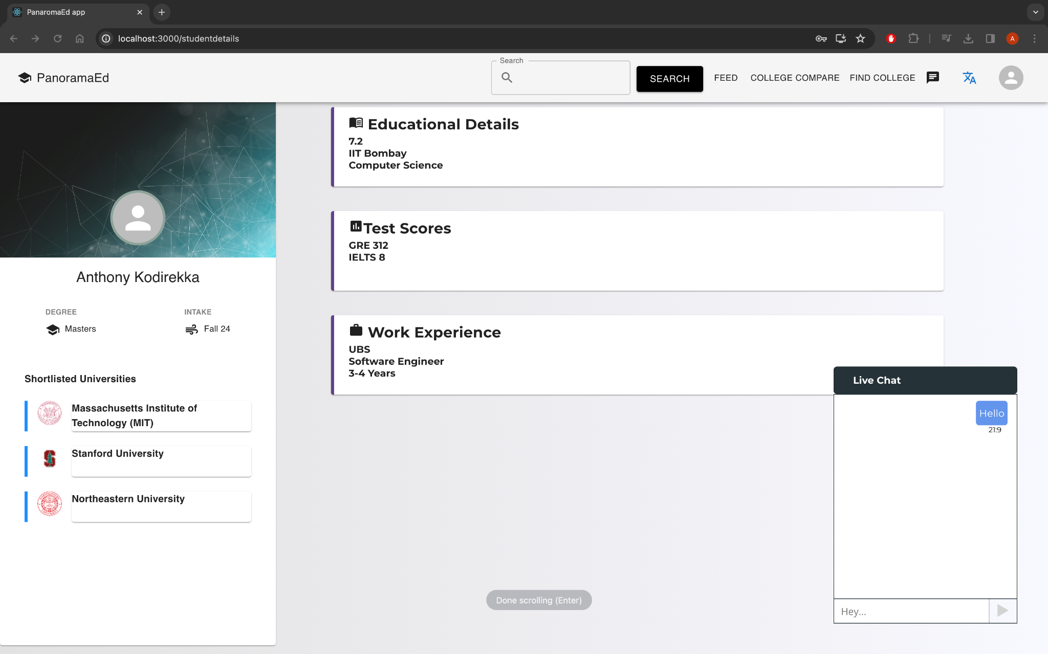

Slide 8
Thank You

